Slide 1


Slide 2

Deutsch Jozsa Algorithm
Basel Abdul Majid,
Javaria Ghafoor,
Alizah Gul Memon.

Slide 3
Contents
Introduction
Calculations
Computation on Jupyter
Sandwiches!

Slide 4
Introduction

Slide 5
Introduction
Brief Mention of Quantum Supremacy
Problem Statement (balanced/constant functions)
Classical Attempt (Mention the worst possible scenario)
DJ Algorithm

Slide 6
History and Significance
Deterministic quantum algorithm
Proposed by David Deutsch and Richard Jozsa in 1992
Improved by Richard Cleve, Artur Ekert, Chiara Macchiavello, and Michele Mosca in 1998.
Inspired Simon’s Algorithm, Shor's Algorithm
One of the first of its kind. In a way, maybe our first step to quantum supremacy
Generalizes earlier (1985) work by David Deutsch

Slide 7

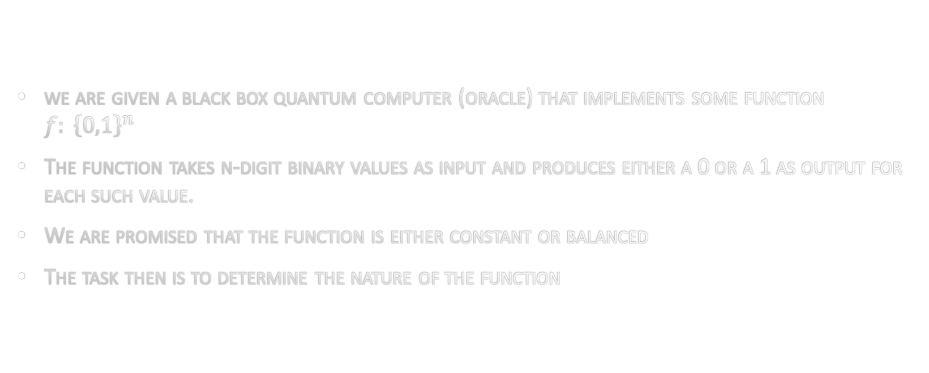
Problem Statement
we are given a black box quantum computer (oracle) that implements some function $f: {\left\{0,1\right\}}^{n}$
The function takes n-digit binary values as input and produces either a 0 or a 1 as output for each such value.
We are promised that the function is either constant or balanced
The task then is to determine the nature of the function
$$\left\{0,1\right\}$$

Slide 8






Deutsch’s Problem
Binary function: $f\left(x\right)$
$$\begin{matrix}1 \\ 0\end{matrix}$$
$$\begin{matrix}0 \\ 1\end{matrix}$$
$$\begin{matrix}1 \\ 1\end{matrix}$$
$$\begin{matrix}0 \\ 0\end{matrix}$$
$$\begin{matrix}0 \\ 1\end{matrix}=$$

Slide 9
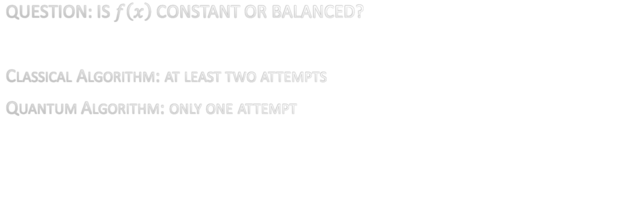
Deutsch-Jozsa Algorithm
QUESTION: IS $f\left(x\right)$ CONSTANT OR BALANCED?
Classical Algorithm: at least two attempts
Quantum Algorithm: only one attempt

Slide 10
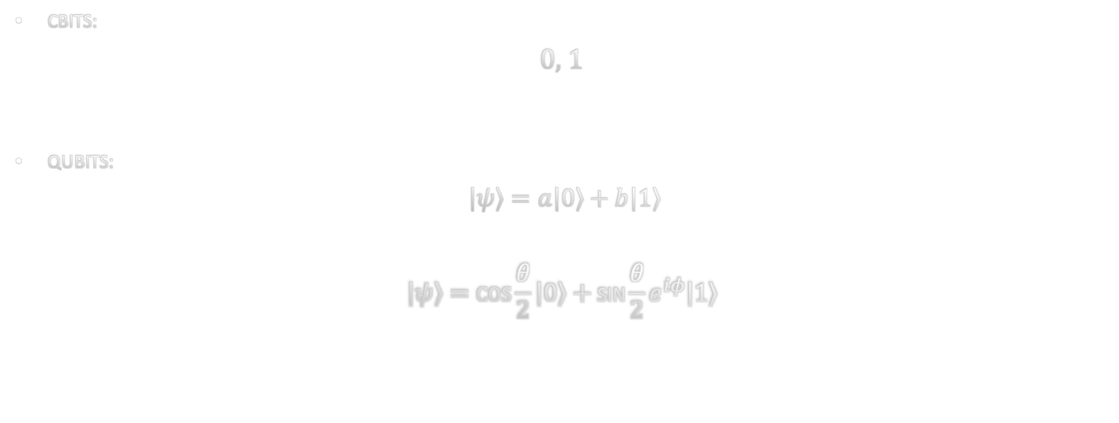
Qubits
CBITS:
0, 1
QUBITS:
$\left|ψ\right\rangle =a\left|0\right\rangle +b\left|1\right\rangle$
$$\left|ψ\right\rangle =\cos{\frac{θ}{2}}\left|0\right\rangle +\text{sin}{\frac{θ}{2}}e^{iφ}\left|1\right\rangle$$

Slide 11
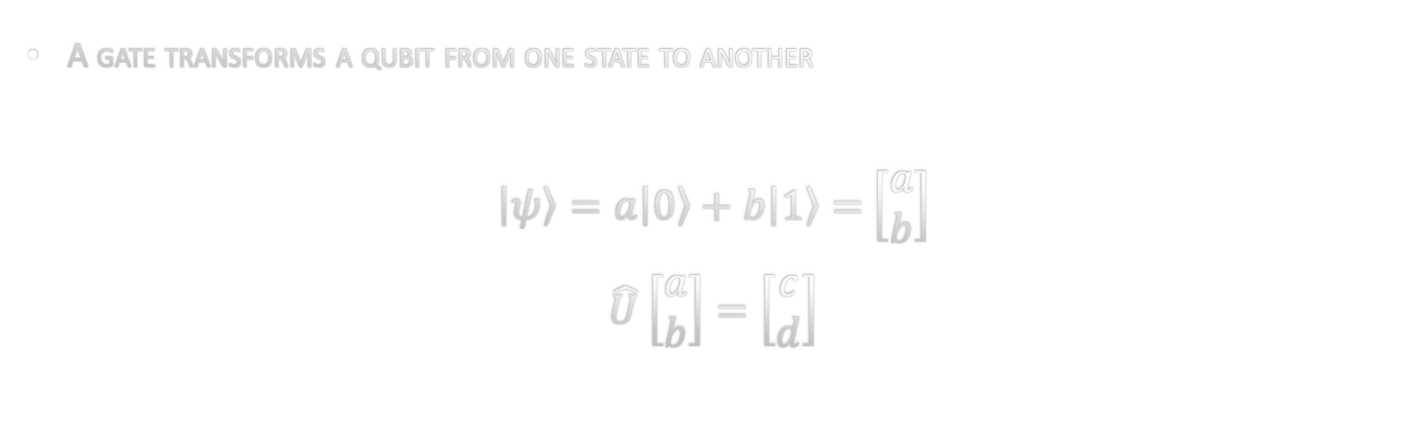
Quantum Gates
A gate transforms a qubit from one state to another
$\left|ψ\right\rangle =a\left|0\right\rangle +b\left|1\right\rangle =$ $\left[\begin{matrix}a \\ b\end{matrix}\right]$
$\hat{U}$ $\left[\begin{matrix}a \\ b\end{matrix}\right]=\left[\begin{matrix}c \\ d\end{matrix}\right]$

Slide 12
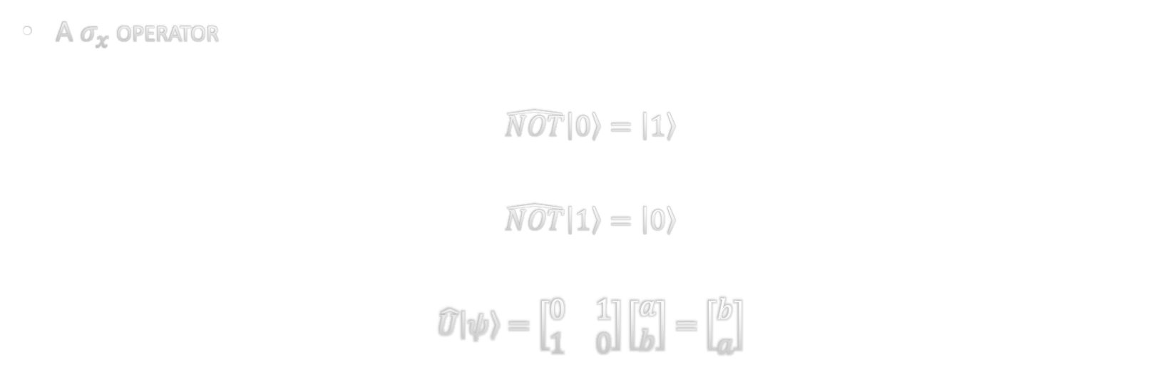
not Gate
A $σ_{x}$ operator
$$\hat{NOT}\left|0\right\rangle =\left|1\right\rangle$$
$$\hat{NOT}\left|1\right\rangle =\left|0\right\rangle$$
$$\hat{U}\left|ψ\right\rangle =\left[\begin{matrix}0 & 1 \\ 1 & 0\end{matrix}\right]\left[\begin{matrix}a \\ b\end{matrix}\right]=\left[\begin{matrix}b \\ a\end{matrix}\right]$$

Slide 13
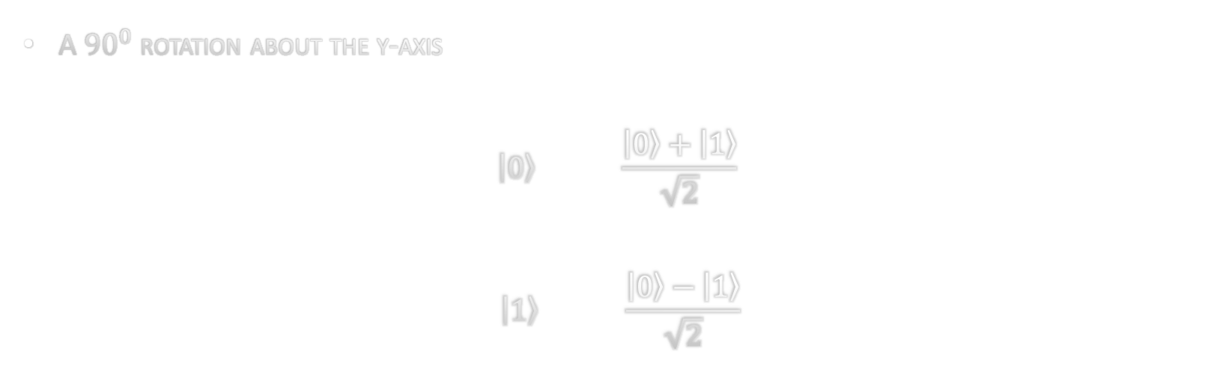
Hadamard Gate
A ${90}^{0}$ rotation about the y-axis
$$\left|0\right\rangle \frac{\left|0\right\rangle +\left|1\right\rangle }{\sqrt{2}}$$
$$\left|1\right\rangle \frac{\left|0\right\rangle −\left|1\right\rangle }{\sqrt{2}}$$

Slide 14

Phase shift
$$\left|0\right\rangle \left|0\right\rangle$$
$$\left|1\right\rangle e^{iφ}\left|1\right\rangle$$

Slide 15

Two-input gate - CNOT
Control Bit
Target Bit
$$\left|00\right\rangle \left|00\right\rangle$$
$$\left|01\right\rangle \left|01\right\rangle$$
$$\left|10\right\rangle \left|11\right\rangle$$
$$\left|11\right\rangle \left|10\right\rangle$$

Slide 16
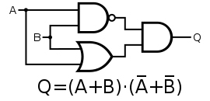




CNOT
$$\left|x\right\rangle$$
CNOT
$$\left|x\right\rangle$$
Exclusive-OR (XOR) Gate
$$\left|y\right\rangle$$
$$\left|x⊕y\right\rangle$$
A | B | OUTPUT
0 | 0 | 0
0 | 1 | 1
1 | 0 | 1
1 | 1 | 0
“ENTANGLER/DETANGLER”

Slide 17
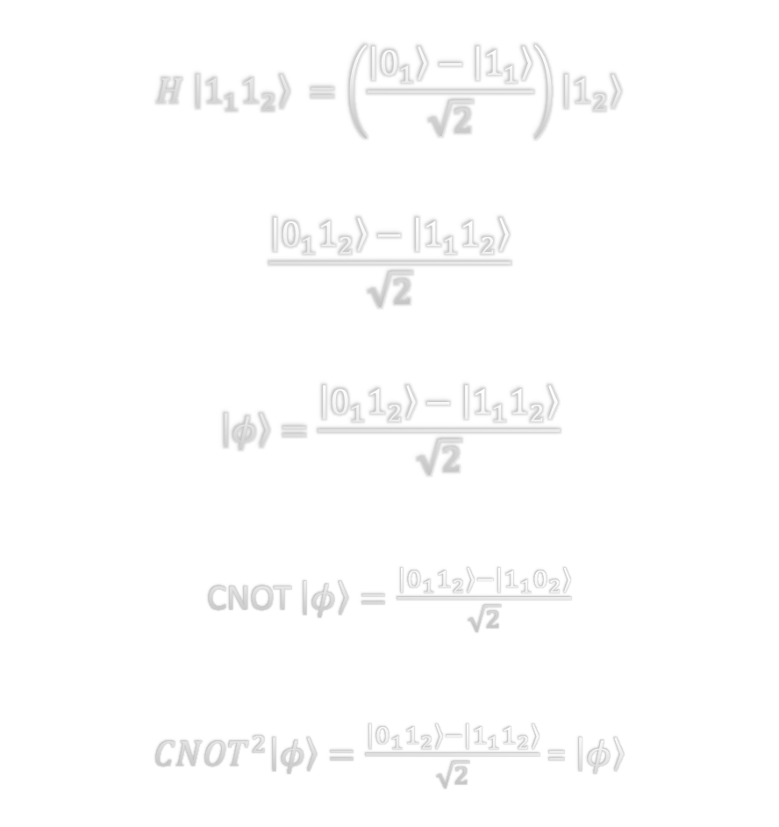
CNOT
$$H \left|1_{1}1_{2}\right\rangle =\left(\frac{\left|0_{1}\right\rangle −\left|1_{1}\right\rangle }{\sqrt{2}}\right)\left|1_{2}\right\rangle$$
$$\frac{\left|0_{1}1_{2}\right\rangle −\left|1_{1}1_{2}\right\rangle }{\sqrt{2}}$$
$$\left|φ\right\rangle =\frac{\left|0_{1}1_{2}\right\rangle −\left|1_{1}1_{2}\right\rangle }{\sqrt{2}}$$
CNOT $\left|φ\right\rangle =\frac{\left|0_{1}1_{2}\right\rangle −\left|1_{1}0_{2}\right\rangle }{\sqrt{2}}$
${CNOT}^{2}\left|φ\right\rangle =\frac{\left|0_{1}1_{2}\right\rangle −\left|1_{1}1_{2}\right\rangle }{\sqrt{2}}$ = $\left|φ\right\rangle$
$$\left|x\right\rangle$$
CNOT
$$\left|x\right\rangle$$
$$\left|y\right\rangle$$
$$\left|x⊕y\right\rangle$$
“ENTANGLER/DETANGLER”

Slide 18








A New gate
$$\left|x\right\rangle$$
CNOT
$$\left|x\right\rangle$$
$$\left|y\right\rangle$$
$$\left|x⊕y\right\rangle$$
$$\left|x\right\rangle$$
f-CNOT
$$\left|x\right\rangle$$
$$\left|y\right\rangle$$
$$\left|f(x)⊕y\right\rangle$$

Slide 19

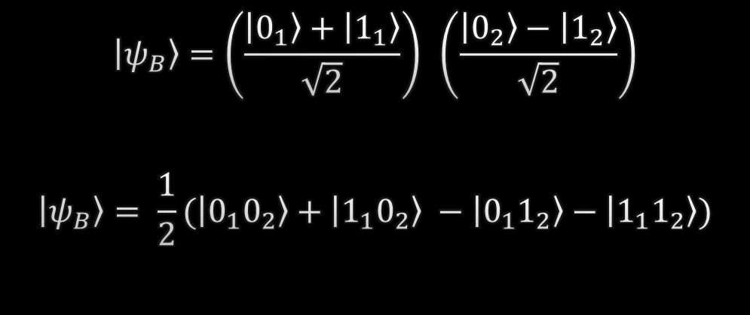




$$\left|x\right\rangle$$
H
f-CNOT
H
$$\left|x\right\rangle$$
$$\left|y\right\rangle$$
H
I
$$\left|f(x)⊕y\right\rangle$$
A
B
$$\left|ψ_{A}\right\rangle =\left|{0_{1}1}_{2}\right\rangle$$
$$\left|ψ_{B}\right\rangle =\left(\frac{\left|0_{1}\right\rangle +\left|1_{1}\right\rangle }{\sqrt{2}}\right) \left(\frac{\left|0_{2}\right\rangle −\left|1_{2}\right\rangle }{\sqrt{2}}\right)$$
$$\left|ψ_{B}\right\rangle = \frac{1}{2}(\left|{0_{1}0}_{2}\right\rangle +\left|{1_{1}0}_{2}\right\rangle −\left|{0_{1}1}_{2}\right\rangle −\left|{1_{1}1}_{2}\right\rangle )$$

Slide 20
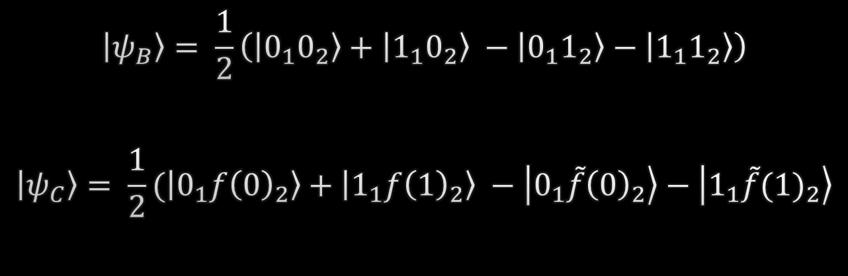
$$\left|x\right\rangle$$
H
f-CNOT
H
$$\left|x\right\rangle$$
$$\left|y\right\rangle$$
H
I
$$\left|f(x)⊕y\right\rangle$$
A
B
C
$$\left|ψ_{B}\right\rangle = \frac{1}{2}\left(\left|{0_{1}0}_{2}\right\rangle +\left|{1_{1}0}_{2}\right\rangle −\left|{0_{1}1}_{2}\right\rangle −\left|{1_{1}1}_{2}\right\rangle \right)$$
$$\left|ψ_{C}\right\rangle = \frac{1}{2}(\left|{0_{1}f\left(0\right)}_{2}\right\rangle +\left|{1_{1}f\left(1\right)}_{2}\right\rangle −\left|{0_{1}\tilde{f}\left(0\right)}_{2}\right\rangle −\left|{1_{1}\tilde{f}(1)}_{2}\right\rangle$$

Slide 21
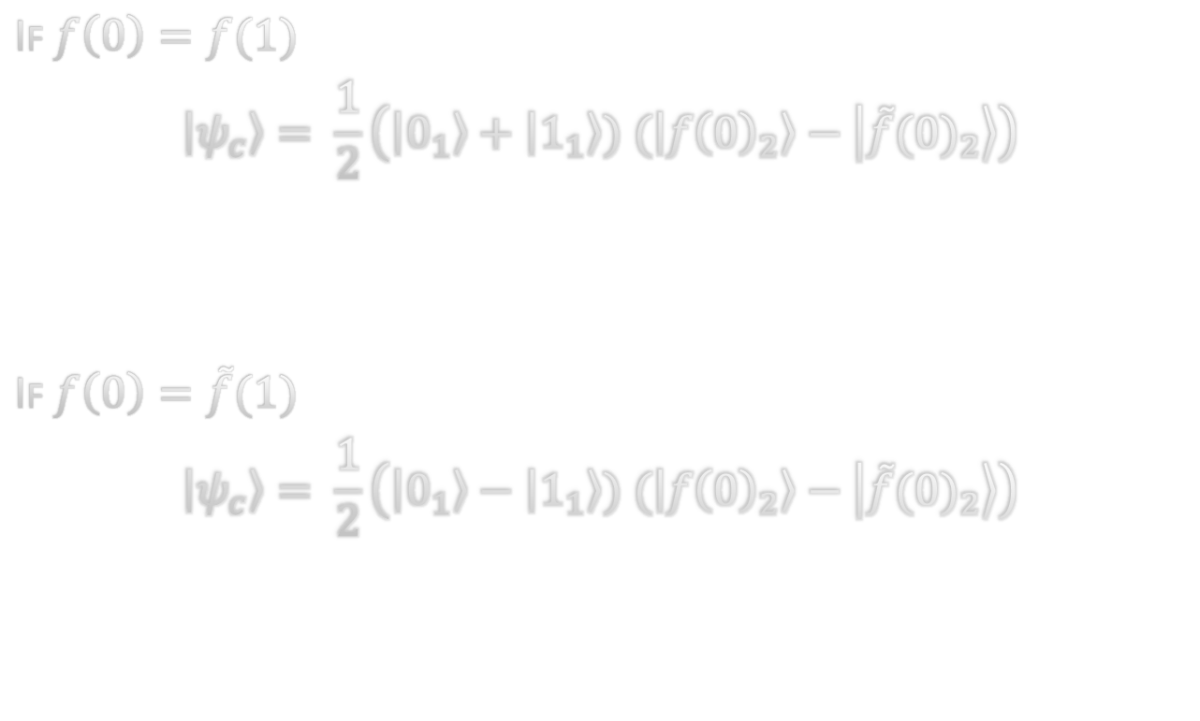
If $f\left(0\right)=f(1)$
$$\left|ψ_{c}\right\rangle = \frac{1}{2}\left(\left|0_{1}\right\rangle +\left|1_{1}\right\rangle ) (\left|{f\left(0\right)}_{2}\right\rangle −\left|\tilde{f}{(0)}_{2}\right\rangle \right)$$
If $f\left(0\right)=\tilde{f}(1)$
$$\left|ψ_{c}\right\rangle = \frac{1}{2}\left(\left|0_{1}\right\rangle −\left|1_{1}\right\rangle ) (\left|{f\left(0\right)}_{2}\right\rangle −\left|\tilde{f}{(0)}_{2}\right\rangle \right)$$

Slide 22
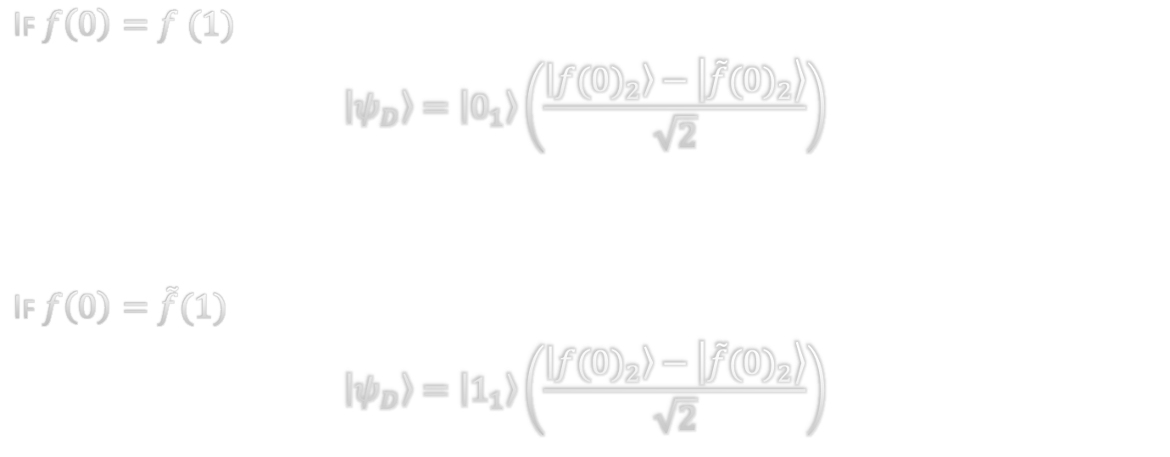
$$\left|x\right\rangle$$
H
f-CNOT
H
$$\left|x\right\rangle$$
$$\left|y\right\rangle$$
H
I
$$\left|f(x)⊕y\right\rangle$$
A
B
C
D
If $f\left(0\right)=f (1)$
$$\left|ψ_{D}\right\rangle =\left|0_{1}\right\rangle \left(\frac{\left|{f(0)}_{2}\right\rangle −\left|\tilde{f}{(0)}_{2}\right\rangle }{\sqrt{2}}\right)$$
If $f\left(0\right)=\tilde{f}(1)$
$$\left|ψ_{D}\right\rangle =\left|1_{1}\right\rangle \left(\frac{\left|{f(0)}_{2}\right\rangle −\left|\tilde{f}{(0)}_{2}\right\rangle }{\sqrt{2}}\right)$$

Slide 23

Dense mathematics

Slide 24
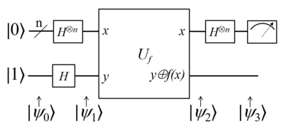




The Hadamard gate is defined as below
$$H=\frac{\left|0\right\rangle +|1⟩ }{\sqrt{2}}\left\langle 0\right|+ \frac{\left|0\right\rangle −|1⟩}{\sqrt{2}}⟨1|$$
We may generalize this for x qubit as
$$\text{Where} H^{⊗n} is defined as H^{⊗n}=H⊗…⊗H$$
$$H|x⟩= \sum_{z∈\{0,1\}}{\frac{{(−1)}^{xz}|z⟩}{\sqrt{2}}}$$
Hadamard on 'n' number of qubits in zero state
$$H^{⊗n}{|0⟩}^{⊗n}=H\left|0\right\rangle ⊗…⊗H|0⟩$$
$=\frac{\left|0\right\rangle +|1⟩ }{\sqrt{2}}⊗…⊗\frac{\left|0\right\rangle +|1⟩ }{\sqrt{2}}$ = $\frac{1}{\sqrt{2}}\sum_{x=0}^{2^{n−1}}{|x⟩}$

Slide 25




Initial state:
$$\left|ψ_{0}\right\rangle ={|0⟩}^{⊗n}|1⟩$$
State one:
$$\left|ψ_{1}\right\rangle ={H^{⊗n}|0⟩}^{⊗n}H\left|1\right\rangle = \frac{1}{\sqrt{2^{n}}}\sum_{x∈{\left\{0,1\right\}}^{n}}{\left|x\right\rangle \frac{\left|0\right\rangle −|1⟩}{\sqrt{2}}}$$
Action of black box
$$U_{f}\left|x\right\rangle \left|0\right\rangle =\left|x\right\rangle \left|0⊕f\left(x\right)\right\rangle =\left|x\right\rangle |f\left(x\right)⟩$$
And
$$U_{f}\left|x\right\rangle \left|1\right\rangle =\left|x\right\rangle \left|1⊕f\left(x\right)\right\rangle$$
Generalized as
$$U_{f}\left|x\right\rangle \frac{\left|0\right\rangle −|1⟩}{\sqrt{2}}= \frac{\left|x\right\rangle \left|f\left(x\right)\right\rangle −\left|x\right\rangle \left|1⊕f\left(x\right)\right\rangle }{\sqrt{2}}$$

Slide 26





For f(x) = 0
$U_{f}\left|x\right\rangle \frac{\left|0\right\rangle −|1⟩}{\sqrt{2}}$ = $\frac{\left|x\right\rangle }{\sqrt{2}}(|0⟩−|1⟩)$
For f(x) = 1
$U_{f}\left|x\right\rangle \frac{\left|0\right\rangle −|1⟩}{\sqrt{2}}$ = $\frac{\left|x\right\rangle }{\sqrt{2}}(|1⟩−|0⟩)$
Or
= $\frac{−\left|x\right\rangle }{\sqrt{2}}(|0⟩−|1⟩)$
Generalized as
$U_{f}\left|x\right\rangle \frac{\left|0\right\rangle −|1⟩}{\sqrt{2}}$ = ${\left(−1\right)}^{f\left(x\right)}\frac{\left|x\right\rangle }{\sqrt{2}}(|1⟩−|0⟩)$
And So giving State 2 as
$${|ψ}_{2}⟩=\sum_{x∈{\left\{0,1\right\}}^{n}}{\frac{{\left(−1\right)}^{f\left(x\right)}|x⟩}{\sqrt{2^{n}}}}\left(\frac{\left|0\right\rangle −|1⟩}{\sqrt{2}}\right)$$

Slide 27
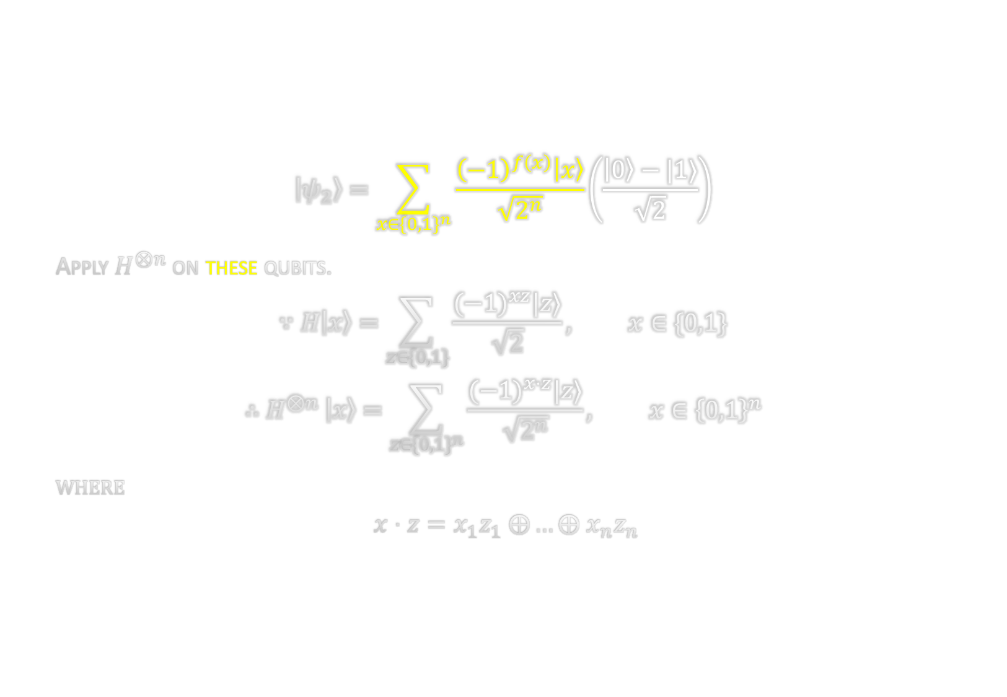
$$\left|ψ_{2}\right\rangle =\sum_{x∈{\{0,1\}}^{n}}{\frac{{\left(−1\right)}^{f\left(x\right)}\left|x\right\rangle }{\sqrt{2^{n}}}\left(\frac{\left|0\right\rangle −|1⟩}{\sqrt{2}}\right)}$$
Apply $H^{⊗n }$on these qubits.
$$∵H\left|x\right\rangle =\sum_{z∈\{0,1\}}{\frac{{(−1)}^{xz}|z⟩}{\sqrt{2}}}, x∈\{0,1\}$$
$$∴H^{⊗n }\left|x\right\rangle =\sum_{z∈{\{0,1\}}^{n}}{\frac{{(−1)}^{x⋅z}|z⟩}{\sqrt{2^{n}}}}, x∈{\left\{0,1\right\}}^{n}$$
where
$$x⋅z=x_{1}z_{1} ⨁…⨁ x_{n}z_{n}$$

Slide 28
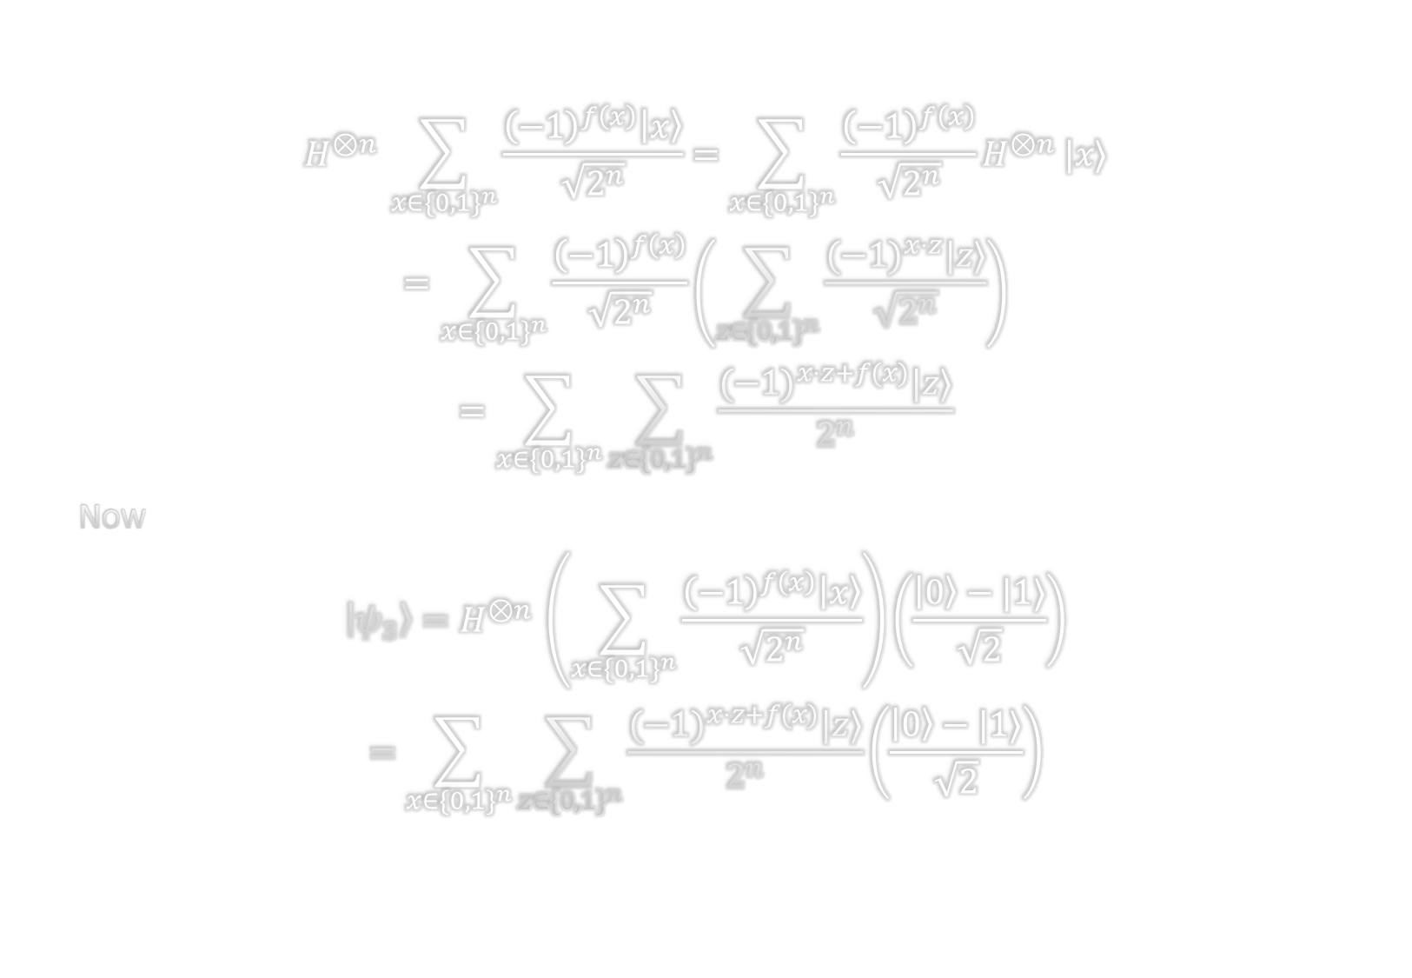
$$H^{⊗n }\sum_{x∈{\{0,1\}}^{n}}{\frac{{\left(−1\right)}^{f\left(x\right)}\left|x\right\rangle }{\sqrt{2^{n}}}}=\sum_{x∈{\{0,1\}}^{n}}{\frac{{\left(−1\right)}^{f\left(x\right)}}{\sqrt{2^{n}}}H^{⊗n }|x⟩}$$
$$=\sum_{x∈{\{0,1\}}^{n}}{\frac{{\left(−1\right)}^{f\left(x\right)}}{\sqrt{2^{n}}}\left(\sum_{z∈{\{0,1\}}^{n}}{\frac{{(−1)}^{x⋅z}|z⟩}{\sqrt{2^{n}}}}\right)}$$
$$=\sum_{x∈{\{0,1\}}^{n}}{\sum_{z∈{\{0,1\}}^{n}}{\frac{{(−1)}^{x⋅z+f(x)}|z⟩}{2^{n}}}}$$
Now
$$\left|ψ_{3}\right\rangle =H^{⊗n }\left(\sum_{x∈{\{0,1\}}^{n}}{\frac{{\left(−1\right)}^{f\left(x\right)}\left|x\right\rangle }{\sqrt{2^{n}}}}\right)\left(\frac{\left|0\right\rangle −|1⟩}{\sqrt{2}}\right)$$
$$=\sum_{x∈{\{0,1\}}^{n}}{\sum_{z∈{\{0,1\}}^{n}}{\frac{{(−1)}^{x⋅z+f(x)}|z⟩}{2^{n}}}}\left(\frac{\left|0\right\rangle −|1⟩}{\sqrt{2}}\right)$$

Slide 29
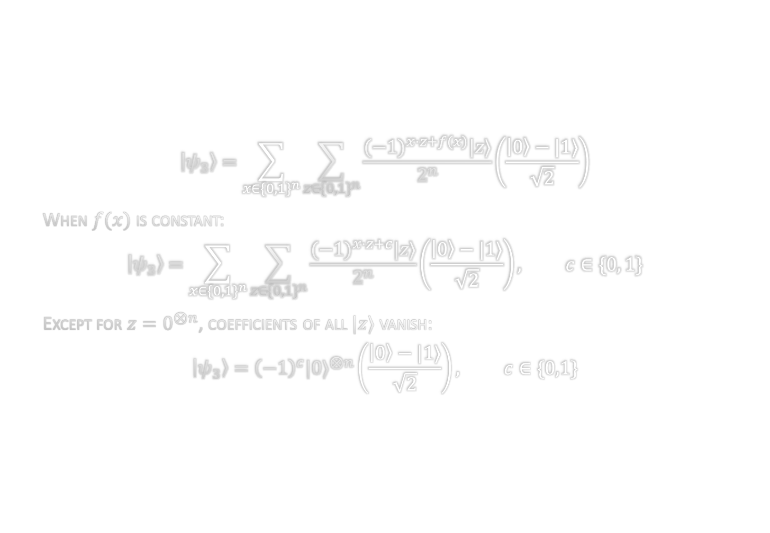
$$\left|ψ_{3}\right\rangle =\sum_{x∈{\{0,1\}}^{n}}{\sum_{z∈{\{0,1\}}^{n}}{\frac{{(−1)}^{x⋅z+f(x)}|z⟩}{2^{n}}}}\left(\frac{\left|0\right\rangle −|1⟩}{\sqrt{2}}\right)$$
When $f(x)$ is constant:
$$\left|ψ_{3}\right\rangle =\sum_{x∈{\{0,1\}}^{n}}{\sum_{z∈{\{0,1\}}^{n}}{\frac{{(−1)}^{x⋅z+c}|z⟩}{2^{n}}}}\left(\frac{\left|0\right\rangle −|1⟩}{\sqrt{2}}\right), c∈\{0, 1\}$$
Except for $z=0^{⊗n}$, coefficients of all $|z⟩$ vanish:
$$\left|ψ_{3}\right\rangle ={\left(−1\right)}^{c}{|0⟩}^{⊗n}\left(\frac{\left|0\right\rangle −|1⟩}{\sqrt{2}}\right), c∈\{0,1\}$$

Slide 30
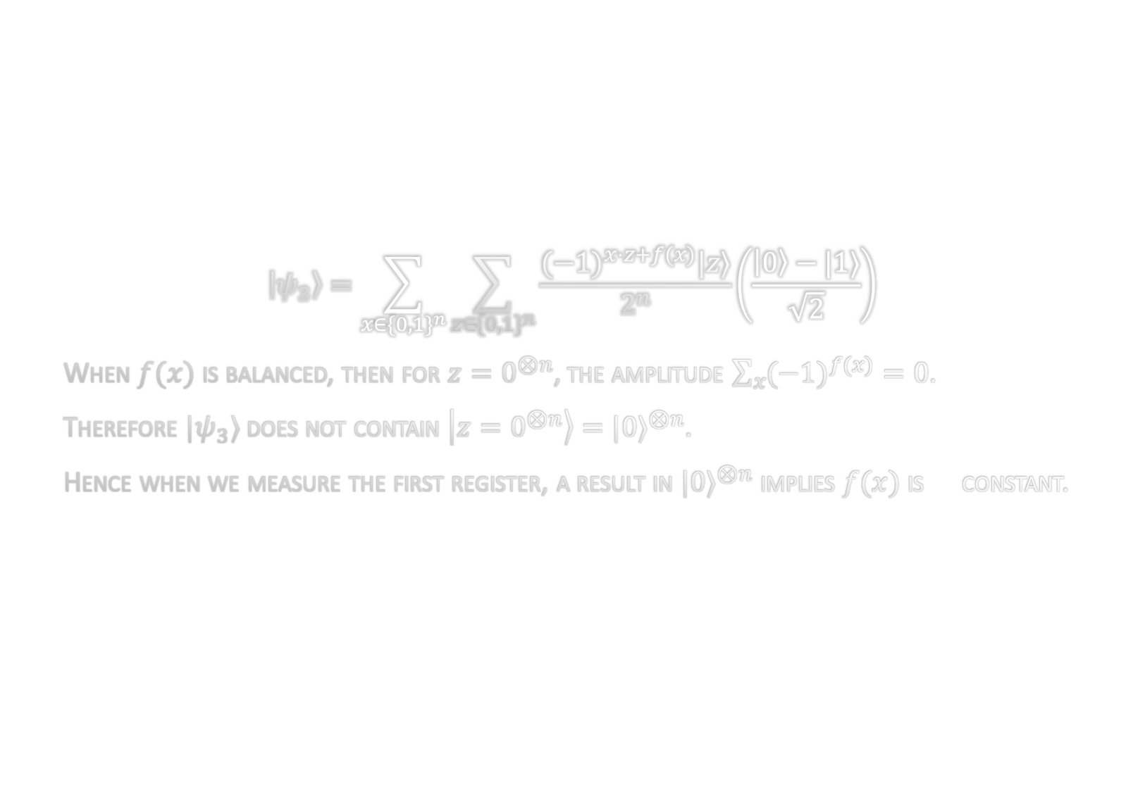
$$\left|ψ_{3}\right\rangle =\sum_{x∈{\{0,1\}}^{n}}{\sum_{z∈{\{0,1\}}^{n}}{\frac{{(−1)}^{x⋅z+f(x)}|z⟩}{2^{n}}}}\left(\frac{\left|0\right\rangle −|1⟩}{\sqrt{2}}\right)$$
When $f(x)$ is balanced, then for $z=0^{⊗n}$, the amplitude $\sum_{x}{{(−1)}^{f(x)}}=0$.
Therefore ${|ψ}_{3}⟩$ does not contain $\left|z=0^{⊗n}\right\rangle ={|0⟩}^{⊗n}$.
Hence when we measure the first register, a result in ${|0⟩}^{⊗n}$ implies $f(x)$ is constant.

Slide 31

Quantum Computation

Slide 32
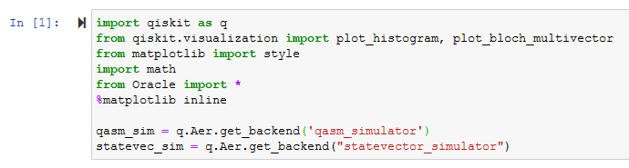

Slide 33
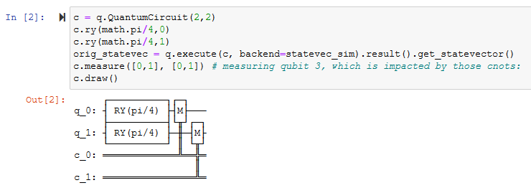

Slide 34
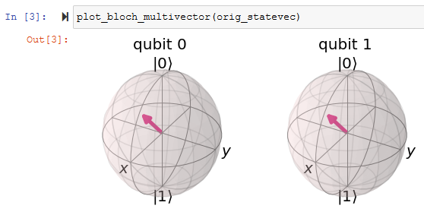

Slide 35
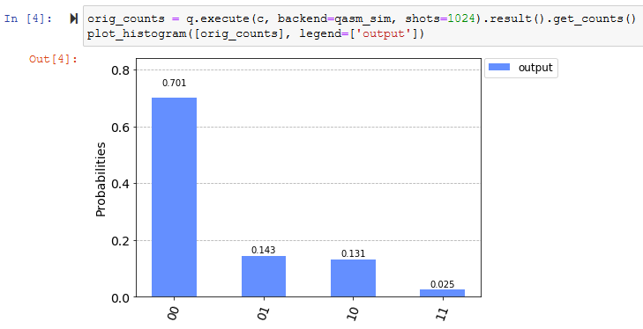

Slide 36
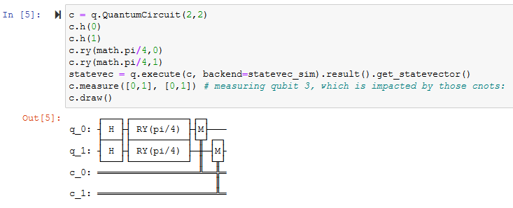

Slide 37
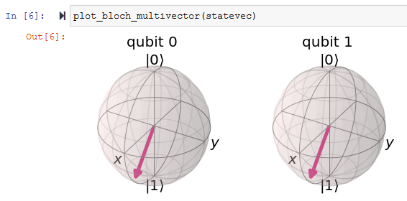

Slide 38
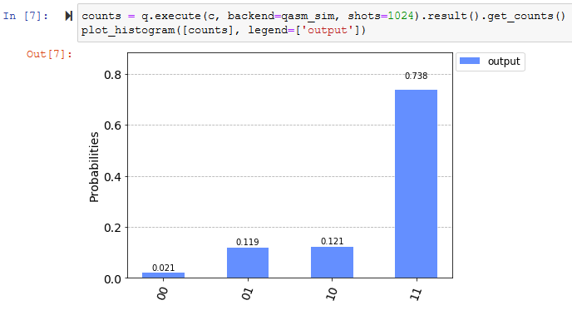

Slide 39
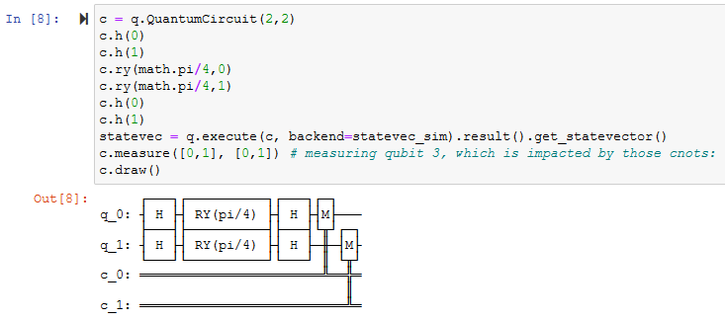

Slide 40
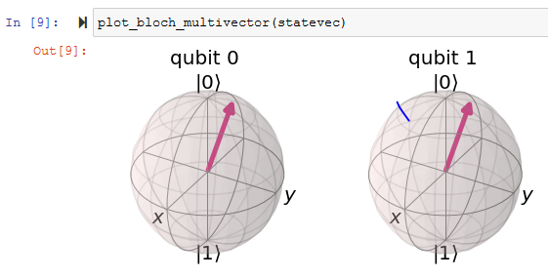

Slide 41
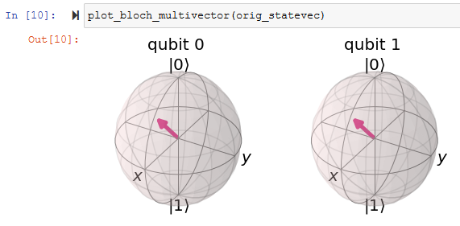

Slide 42
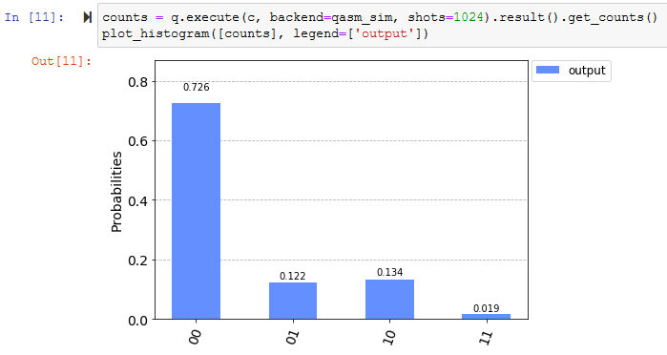

Slide 43
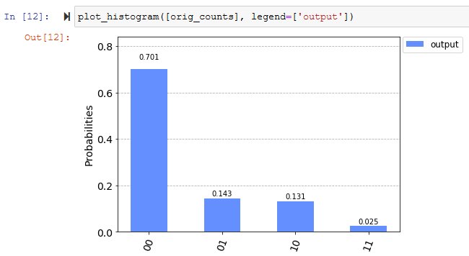

Slide 44
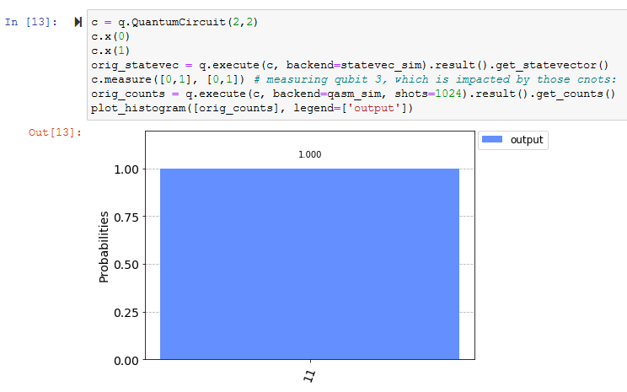

Slide 45
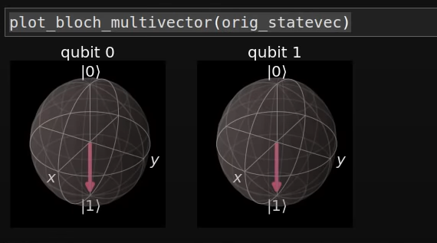

Slide 46
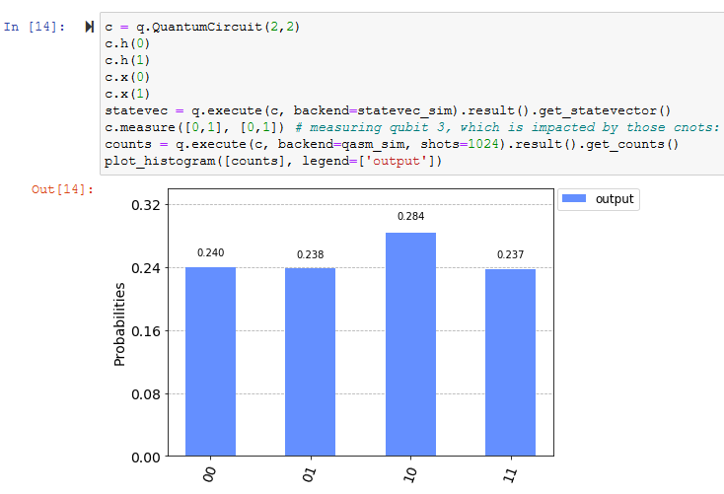

Slide 47
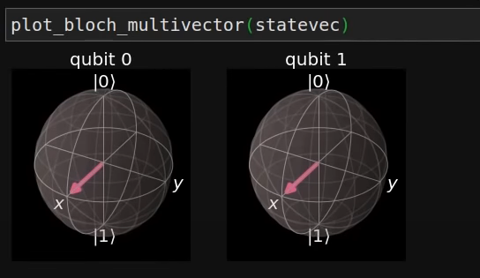

Slide 48
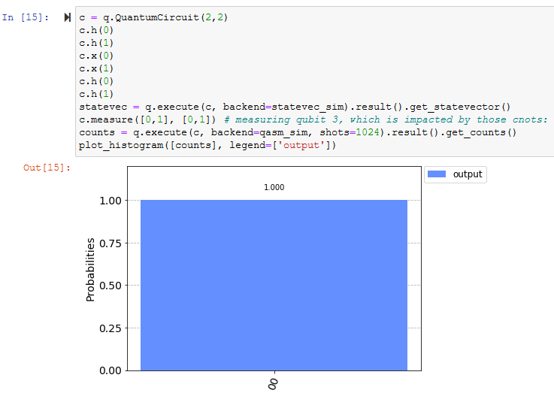

Slide 49
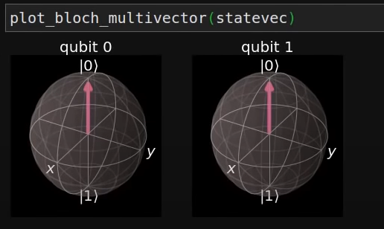

Slide 50
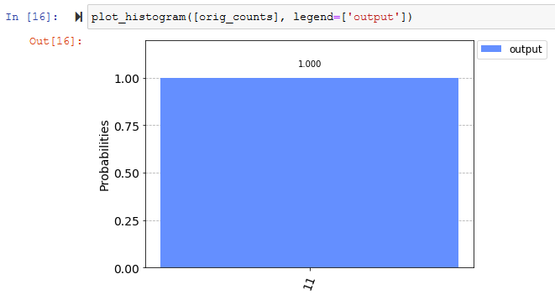

Slide 51
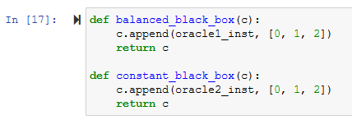

Slide 52
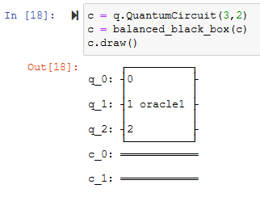

Slide 53
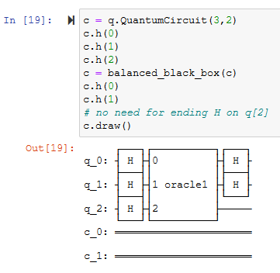

Slide 54
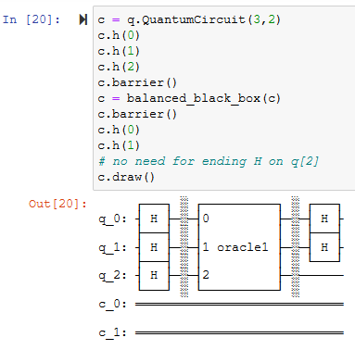

Slide 55
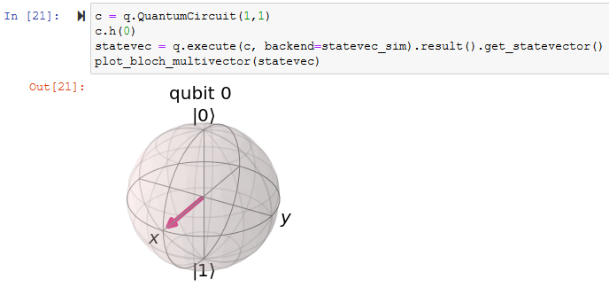

Slide 56
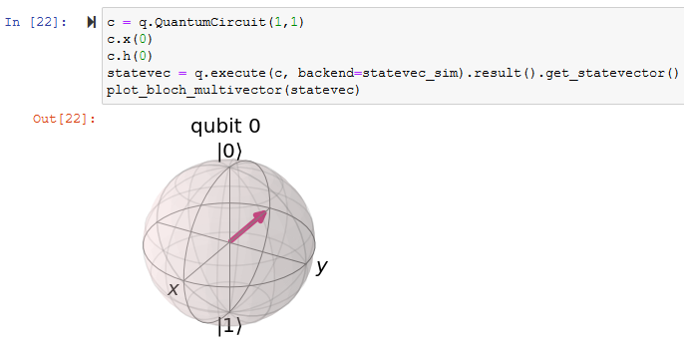

Slide 57
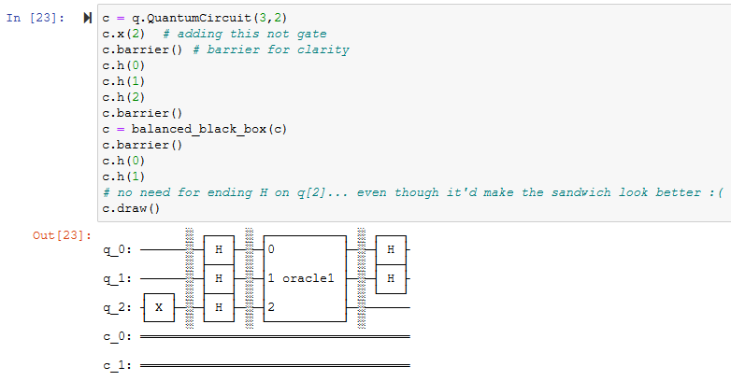

Slide 58
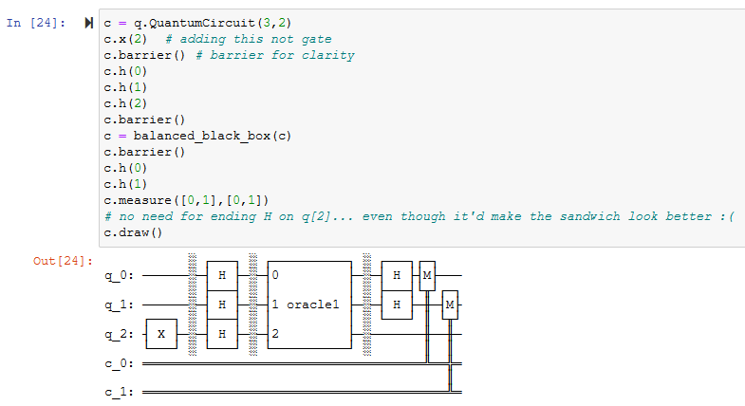

Slide 59
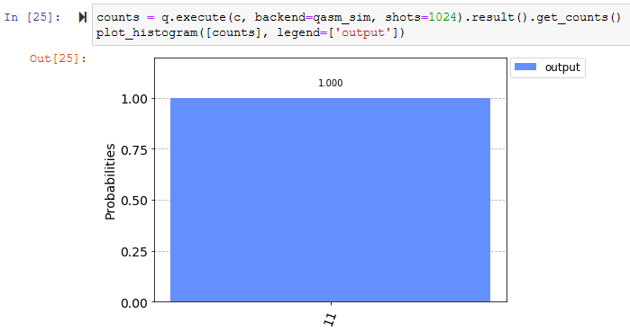

Slide 60
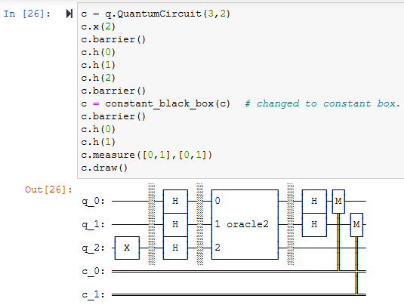

Slide 61


Slide 62
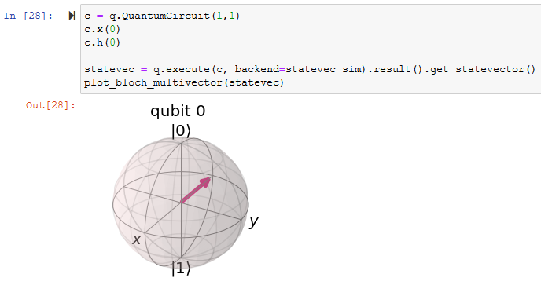

Slide 63
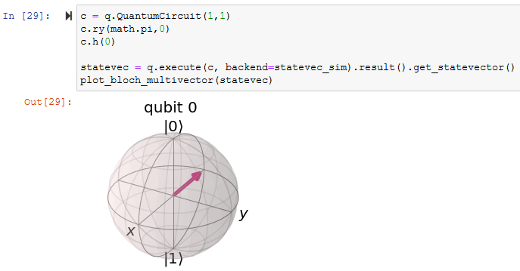

Slide 64
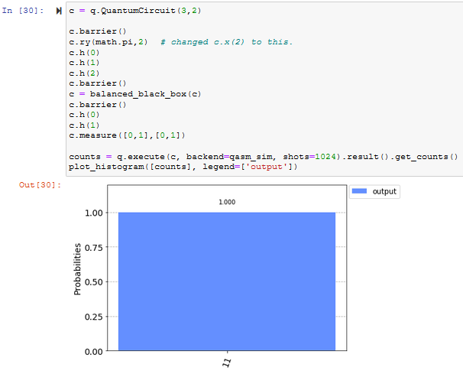

Slide 65
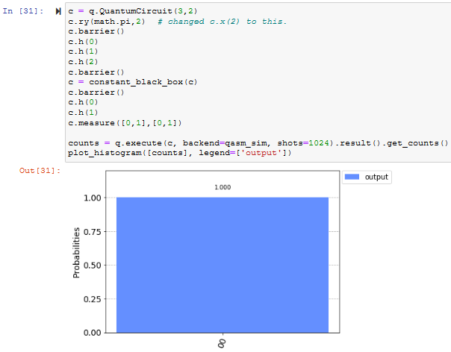

Slide 66


Slide 67


Slide 68


Slide 69


Slide 70

The Black Box

Slide 71


Slide 72


Slide 73


Slide 74


Slide 75


Slide 76

ANY QUESTIONS

